Slide 1
CS 101 Introduction to Computer Science
Introduce students to the modern, state-of-the-art Information Technology
provide them the adequate skills in basic computer science to professionally use I.T.
in the context of a traditional liberal arts education of critical thinking and problem-solving,
and in a standard business environment.

Slide 2
Your instructor (Stefano Gazziano)
Physics, Laurea [MSc] 1983 University of Rome.
Fulbrighter at Georgia Tech 1986.
IT consultant to ENI 87-93.
Visiting scientist at UC Berkeley 1994.
Adjunct prof at John Cabot University in Rome 1999 to present.
Head of technology transfer programs at ENEA the Italian Energy Agency.
IT experience from 1978 punching cards to today. Personal web page on UC Berkeley systems June 1994

Slide 3
Grading Policy
ASSESSMENT METHODS:
There will be a bi-weekly tests plus Midterm and Final
Tests will include all subjects covered in previous weeks.
ASSESSMENT CRITERIA:
25% Attendance and class participation
25% Tests
25% Midterm
25% Final

Slide 4
JCU assessment guidelines
Grade | Assessment
A | Work of this quality directly addresses the question or problem raised and provides a coherent argument displaying an extensive knowledge of relevant information or content. This type of work demonstrates the ability to critically evaluate concepts and theory and has an element of novelty and originality. There is clear evidence of a significant amount of reading beyond that required for the course
B | This is highly competent level of performance and directly addresses the question or problem raised.There is a demonstration of some ability to critically evaluatetheory and concepts and relate them to practice. Discussions reflect the student’s own arguments and are not simply a repetition of standard lecture andreference material. The work does not suffer from any major errors or omissions and provides evidence of reading beyond the required assignments.
C | This is an acceptable level of performance and provides answers that are clear but limited, reflecting the information offered in the lectures and reference readings.

Slide 5
JCU assessment guidelines
Grade | Assessment
A | Work of this quality directly addresses the question or problem raised and provides a coherent argument displaying an extensive knowledge of relevant information or content. This type of work demonstrates the ability to critically evaluate concepts and theory and has an element of novelty and originality. There is clear evidence of a significant amount of reading beyond that required for the course
B | This is highly competent level of performance and directly addresses the question or problem raised.There is a demonstration of some ability to critically evaluatetheory and concepts and relate them to practice. Discussions reflect the student’s own arguments and are not simply a repetition of standard lecture andreference material. The work does not suffer from any major errors or omissions and provides evidence of reading beyond the required assignments.
C | This is an acceptable level of performance and provides answers that are clear but limited, reflecting the information offered in the lectures and reference readings.
A means OUTSTANDING
B means VERY GOOD
C = THAT’S JUST OK

Slide 6
JCU assessment guidelines
Grade | Assessment
D | This level of performances demonstrates that the student lacks a coherent grasp of the material. Important information is omitted and irrelevant points included.In effect, the student has barely done enough to persuade the instructor that s/he should not fail.
F | This work fails to show any knowledge or understanding of the issues raised in the question. Most of the material in the answer is irrelevant.

Slide 7
JCU assessment guidelines
Grade | Assessment
D | This level of performances demonstrates that the student lacks a coherent grasp of the material. Important information is omitted and irrelevant points included.In effect, the student has barely done enough to persuade the instructor that s/he should not fail.
F | This work fails to show any knowledge or understanding of the issues raised in the question. Most of the material in the answer is irrelevant.
I do not even want to talk about this

Slide 8
Class schedules and syllabi
See the academic course schedule and syllabus

Slide 9
Course requirements
This is a BEGINNERS class
No PC experience is required, we do start from scratch.
CS101 will mehodically take you to acquire the basic skills necessary for efficient and correct usageof standard IT in college and business.
If you feel confident you have all the competences listed in the syllabus (next slide) you can skip the class, please feel free to discuss this with the prof

Slide 10
SUMMARY OF COURSE CONTENT:
Computers architecture and technology
Software layers: operating systems and application software
How to troubleshoot basic issues (plugging in laptops to overheads etc.) How to use a computer and do basic troubleshooting; how to move to another computer.
Organizing and managing your own data: file systems and file/folder management.
Networks architecture and protocols. Data storage and backup. Local Network, Intranet, Internet. Access to data at different locations

Slide 11
SUMMARY OF COURSE CONTENT:
Introduction to Microsoft Office Package and how to use it. Ms Word. MS Excel. MS Powerpoint. Prezi.
Publishing and editing
Cloud computing: the new paradigm. Local application v/s cloud suites. Google drive / Icloud / Dropbox
Professional presentation of information and computer etiquette.
How the Web works: servers and browsers. Introduction to Web design: how to create a web site to express ideas graphically. Writing for the web.
Databases and Multimedia.

Slide 12
SUMMARY OF COURSE CONTENT:
Use of primary data to manipulate into usable and well-documented formats so as to be able to communicate this information to end users
Collaboration on documents: how to collaborate and gain synergies from working with other people
Creating multimedia documents and copyright issues associated with digital sources
Privacy and personal data protection on the Internet. Mobile computing, location based services.
Computer and network security : viruses, frauds, fishing, spoofing, scam, secure protocols, safe user behaviour.
Searching with Google or gathering information from the Internet; being aware of the standard sources of information

Slide 13
General rules in class
Open internet access for class purposes only, no chat, mail, browsing etc unrelated to class topics
NO FACEBOOK, unless on class page
Quiet collaboration allowed, except during tests of any kind
Students found doing their own business on PCs during class will be kindly allowed to it elsewhere

Slide 14
Yes we have a class Facebook page ...

Slide 15
Window of the future: our «Roster in the Cloud»
Request access by email to sgazziano@johncabot.edu

Slide 16
What is «Cloud Computing btw ??»

Slide 17
Ok, back to the basics – we’ll be on the Cloud again later on
IT is all about Information processing system
Quality of output data depends on processing AND input data
Very Important Corollary : “garbage in” = “garbage out”
no matter how complex the processing

Slide 18
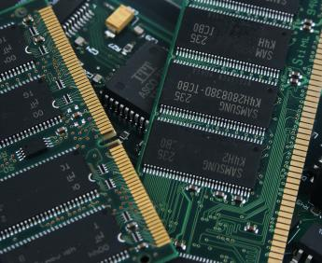
All computers were created equal: or: below please find any computer basic architecture
i.e. the Hard Disk
The RAM (random access memory)

Slide 19
Ok, back to the basics – we’ll be on the Cloud again later on

Slide 20
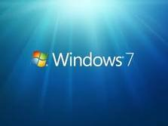
About the Hardware – any computer

Slide 21
History of computing: Moore’s law
Growth of computer performance is exponential

Slide 22
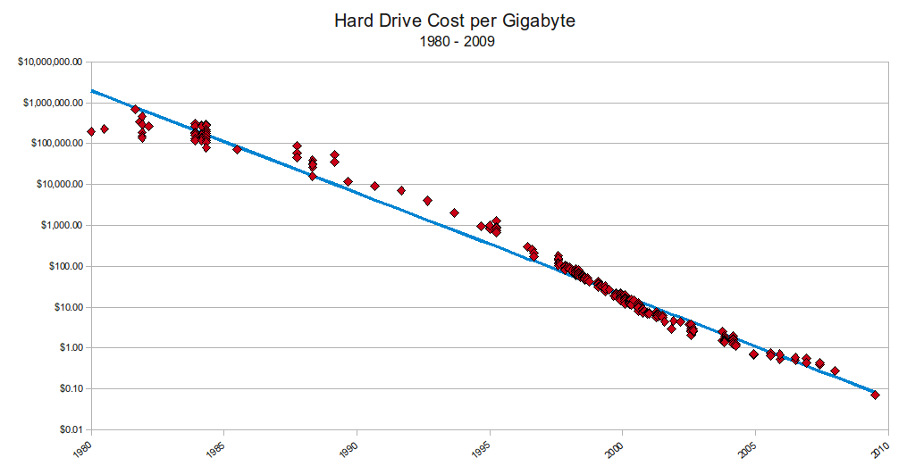
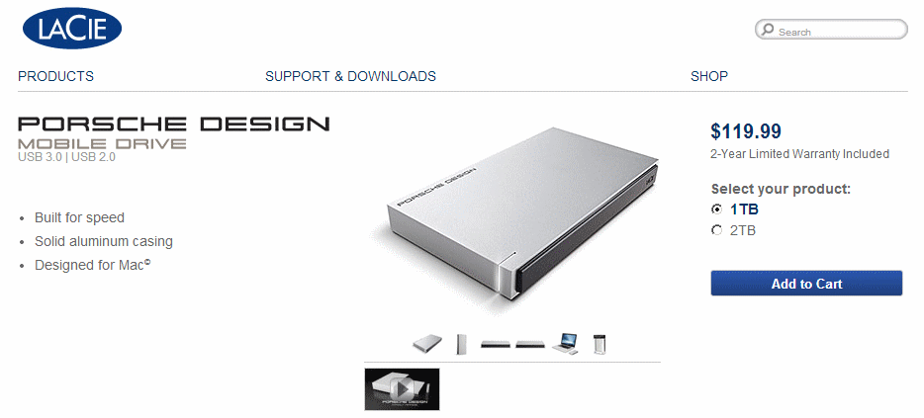
Cost of storage decreases
Storage is getting cheaper
It’s cheaper to add storage rather than manage it.
Capacity on Demand is a great idea
Backed up data is always recoverable.
SAN will lower my costs
1 TB = 1000 GB = 1.000.000 MB = approx 1.428 HD movies
(ok: what is a Byte and what “Tera” means btw??)
Notes:
You know that pcs are getting cheaper an cheaper, or at least that you get more performance for the same cost in due time. Let’s see exactly how much it does….

Slide 23
Innovation v/s costs
Year | Computer | Unit Cost | Memory
1970 | IBM 370 | Monthly rental for a typical System/370 Model 155 having 768,000 bytes of main memory is $47,985, with a purchase price of $2,248,550. Monthly rental for a typical Model 165 with 1-million bytes of main memory is $98,715, with a purchase price of $4,674,160. | Up to 800 MB HD 768kB RAM 1 MB RAM
2013 | APPLE Top-of-the-line iMac 27” | 3.4GHz quad-core Intel Core i5 Turbo Boost up to 3.8GHz 8GB (two 4GB) memory NVIDIA GeForce GTX 775M with 2GB video memory $1,999 | 1TB hard drive 8.000 MB RAM 2.000 MB video

Slide 24
Basic trouble shooting PCs – first things first
Identify PC parts and “ports” (plugs for different use)
Power on works ? (beeps and stops, no power on at all, pc stuck)
Screen shows something meaningful ?? (check cable connected, monitor menu input selection, resolution)
Keyboard, mouse work ? (pwd writes, mouse clicks)
Network connection ok ? (check a news website, check ethernet/wifi
Others: common / ask the internet
Common: keyboard usage, language, output to overhead, volume, drivers what àre and how to install or detect issue.

Slide 25
Basic trouble shooting PCs – first things first
Why the pc is sometimes too slow
Lost files / how do I avoid to waste hours of work
Crashes of the pc, the blue screen and other reasons to crash. Check for viruses (use
Viruses, what they are and what antivirus/firewall programs to use
Printer / drivers / installation of peripherals
Battery life
Complex SW: sometimes the software is too complicated to understant (pls read the manuals)
Mouse freeze
Spam mail
Network failure
Upload failure
Usb fail to identify device

Slide 26
Basic trouble shooting PCs – first things first
Why the pc is sometimes too slow
Latest version software n old (> 5 yrs ago) computers), reinstall older versions if you can, do not upgrade
Too many programs open use task manager (ctrl-alt-del on win, alt-tab on MacOS) and close them
Insufficient memory: add RAM
Lost files / how do I avoid to waste hours of work
learn to save periodically the open file
"save as" when you open attachments directly from mail

Slide 27
Basic trouble shooting PCs – first things first
Crashes, the blue screen and other reasons to crash.
Microsoft suggestions for a computer crash
Microsoft support page for Win 7
Mac troubleshooting: How to handle freezes and crashes
How easy is to crash a computer ? Example
STEP:1- Open Notepad on your PC
STEP:2- copy it from here to your Notepad
(tsk tsk)
STEP:3- Then save it with a .bat extension.
When saving delete the .txt and input the File name with the .bat extension
Example:- fork.bat
STEP:4- Once anyone will do double click on this bat file, his COMPUTER WILL JAMM AND CRASH

Slide 28
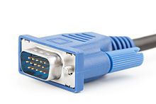
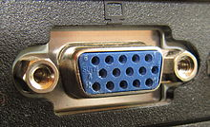
Computer “ports” : hardware ports v/s software ports
HW ports
In computer hardware, a port serves as an interface between the computer and other computers or peripheral devices. Physically, a port is a specialized outlet on a piece of equipment to which a plug or cable connects. Electronically, the several conductors making up the outlet provide a signal transfer between devices.
Port connectors may be male or female, but female connectors are much more common. Bent pins are easier to replace on a cable than on a connector attached to a computer, so it was common to use female connectors for the fixed side of an interface.
SW ports, see later on
male connector female connector

Slide 29
Hardware ports type
Based on the figure identify all ports on your desktop and check where and if they are connected

Slide 30
Resources to troubleshoot PCs
http://computer.howstuffworks.com/23-computer-tour-video.htm
http://www.computerhope.com/basic.htm

Slide 31
PC beeps, power on failure, sleep
If the PC does not power on
System BIOS (basic I/O software) corrupted: try a CD start-up
Basic Input/Output System (BIOS), also known as System BIOS, ROM BIOS or PC BIOS (/ˈbaɪ.oʊs/), is a de factostandard defining a firmware interface.^{[1]} The name originated from the Basic Input/Output System used in the CP/M operating system in 1975.^{[2][3]} The BIOS software is built into the PC, and is the first software run by a PC when powered on. The fundamental purposes of the BIOS are to initialize and test the system hardware components, and to load a bootloader or an operating system from a mass memory device.
Battery life ended: (old PCs left off longtime: leave machine plugged on, disconnect power plug or push power button for few seconds, try again in 5 mins)
Power supply to be replaced
Major problem: refer to support
Issues after power on: fail to recognize a peripheral (USB device, printer, projector, other).
DRIVERS: before any peripheral can operate on the pc (OR Mac)the appropriate software must be installed (i.e. the so called “driver”).
Usually USB peripherals now install themselves automatically. ALWAYS CHECK INSTRUCTIONS BEFORE PLUG IN ANY PERIF. If the perif is not self-installing, and no drivers are correctly installed, the perif will not work usually even after drivers instal. I.E. DRIVERS INSTALLED BEFORE PLUGGING NOT SELF-INSTALLING perif.

Slide 32
Software system (desktop examples)
You (or someone else…)
MS Office or Open Office
Windows , MAC OS X,
Your PC

Slide 33
Most common Operating Systems
Microsoft Windows family
Unix / Linux
Mac OS
Parallel, real-time, mainframe OS

Slide 34
Application software
also known as applications or apps,
is computer software designed to help the user to perform singular or multiple related specific tasks.
Examples include Enterprise software, Accounting software, Office suites, Graphics software and media players.

Slide 35
The FILE SYSTEM (this IS very important)
Anything on a computer is stored in a FILE
FILES are organized in DIRECTORIES aka « folders »
Files can be either on your PC (« local » ) or on the « local network » or on the Internet (« cloud »)

Slide 36
Local computing, Intranet, Internet, cloud
LOCAL (storage or installation) means files are physically on a single PC, or laptop. You can have many local installations of the same files but files are not automatically synced
Local Area Network, or LAN,
a computer network that interconnects computers in a limited area such as a home, school, computer laboratory, or office building using network media. E.G. the JCU “Intranet”.
You can access files ONLY if connected within the premises of the LAN
LAN using Internet protocol are called “INTRANET”
Internet is the network connecting all local network and computers adopting the TCP/IP protocol
Software can be stored on the Internet and directly used “as a platform” or “as a service” (“SaaS”).
The Internet is traditionally graphically represented as a cloud computing, hence this method of operation is called “Cloud Computing”. Examples of distributed systems: Google Suite on Google Drive

Slide 37
An Intranet
An intranet is the use of Web technologies to create a private network, usually within one enterprise.
It is typically a complete LAN, or several intra-connected LANs
Intranets are used for:
work-group activities
the distributed sharing of projects within the enterprise
Controlled access to company financial documents
use of knowledge management, research materials, online training, and other information that requires distribution within the enterprise.

Slide 38
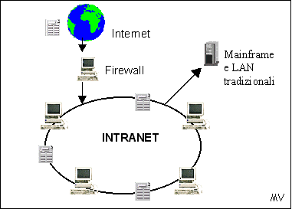
Intranet v/s Internet

Slide 39
The Internet
Sometimes called simply “the Net,” the Internet is a worldwide system of computer networks—a network of networks hence Internet, in which users at any one computer can get information from any other computer
The Internet uses a portion of the total resources of the currently existing public telecommunication networks. Technically, what distinguishes the Internet is its use of a set of protocols called TCP/IP (Transmission Control Protocol/Internet Protocol).

Slide 40
Extranet
Connect several intranets via the Internet, by adding a security mechanism and some additional functionalities
They form a larger virtual network that allows remote users (such as business partners or mobile employees) to securely connect over the Internet to the enterprise’s main intranet.
Extranets are also employed by two or more enterprises (suppliers & buyers) to share information in a controlled fashion, and therefore they play a major role in the development of business-to-business electronic commerce and Supply Chain systems.

Slide 41
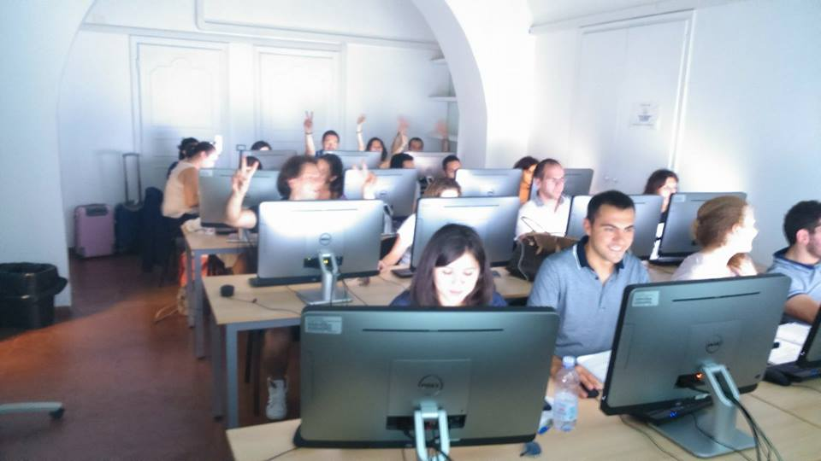
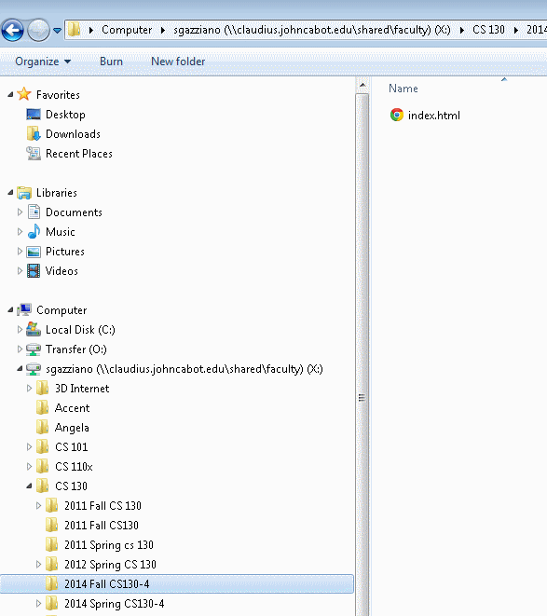
Intranet v/s Internet, 2
Intranet
PC Lab is here
And JCU facilities: MyJCU, X Disk

Slide 42
The World Wide Web
Runs on the Internet, Intranet, Extranet
Uses the Hypertext Protocol (HTTP)
We just call it the Internet, but it is a subset of it

Slide 43
Files on the Web

Slide 45
Web server and web browser are different

Slide 46
Real systems are a bit more complex, yes...

Slide 47
Cloud computing

Slide 48
Cloud Computing : software as a service

Slide 49
Could computing types

Slide 50
Local v/s Network
Local = on your machine(e.g.C:/programs)
Local Network = « Intranet »
X: shared disk (user permissions, permanent)
O: temporary area (cleared periodically)
Accessible only from within JCU premises
Network, a.k.a. « cloud »
Google docs / Icloud / Dropbox / Slideshare / … many …
MS Office 365 / 2013

Slide 51
Google Apps (ex Google docs) : a simple cloud computing

Slide 52
Google Apps: let’s try it
Google Drive (formerly: Google Docs) is a free, Web-based word processor, spreadsheet, presentation, form, and data storage service offered by Google. It allows users to create and edit documents online while collaborating in real-time with other users.

Slide 53
Google Apps: a simple cloud computing
Use a gmail account (preferred, register now if you do not have one)
Send me a mail to sgazziano@johncabot.edu
Wait for the invitation to access the file
Follow my instructions in class

Slide 54
filenames.ext are meaningful

Slide 55
Rules for filenames
Optional filename filename.ext
Standard «extension» filename.ext
A filename (also written as two words, file name) is a name used to uniquely identify a computer file stored in afile system. Different file systems impose different restrictions on filename lengths and the allowed characters within filenames.
A filename may include one or more of these components:
host (or node or server) – network device that contains the file
device (or drive) – hardware device or drive
directory (or path) – directory tree (e.g., X:\CS 101\Teaching material\, etc.)
file – base name of the file
type (format or extension) – indicates the content type of the file (e.g., .txt, .exe, .COM, etc.)
version – revision or generation number of the file
The components required to identify a file varies across operating systems, as does the syntax and format for a valid filename.
File names and file name extensions: frequently asked questions

Slide 56
Files «path»
Find the «path» in the «properties/general» box
Windows masks the real path
Path indicates where to reach the file
on your PC C:
on a network pc e.g. X:
on a MAC Hard Disk (HD name)
etc etc
Wikipedia filenames page is a good recap
File extensions list
List of file formats

