Slide 1
CS 101 Introduction to Computer Science
Introduce students to the modern, state-of-the-art Information Technology
provide them the adequate skills in basic computer science to professionally use I.T.
in the context of a traditional liberal arts education of critical thinking and problem-solving,
and in a standard business environment.

Slide 2
Your instructor (Stefano Gazziano)
Physics, Laurea [MSc] 1983 University of Rome.
Fulbrighter at Georgia Tech 1986.
IT consultant to ENI 87-93.
Visiting scientist at UC Berkeley 1994.
Adjunct prof at John Cabot University in Rome 1999 to present.
Head of technology transfer programs at ENEA the Italian Energy Agency.
IT experience from 1978 punching cards to today. Personal web page on UC Berkeley systems June 1994

Slide 3
Grading Policy
ASSESSMENT METHODS:
There will be a bi-weekly tests plus Midterm and Final
Tests will include all subjects covered in previous weeks.
ASSESSMENT CRITERIA:
25% Attendance and class participation
25% Tests
25% Midterm
25% Final

Slide 4
JCU assessment guidelines
Grade | Assessment
A | Work of this quality directly addresses the question or problem raised and provides a coherent argument displaying an extensive knowledge of relevant information or content. This type of work demonstrates the ability to critically evaluate concepts and theory and has an element of novelty and originality. There is clear evidence of a significant amount of reading beyond that required for the course
B | This is highly competent level of performance and directly addresses the question or problem raised.There is a demonstration of some ability to critically evaluatetheory and concepts and relate them to practice. Discussions reflect the student’s own arguments and are not simply a repetition of standard lecture andreference material. The work does not suffer from any major errors or omissions and provides evidence of reading beyond the required assignments.
C | This is an acceptable level of performance and provides answers that are clear but limited, reflecting the information offered in the lectures and reference readings.

Slide 5
JCU assessment guidelines
Grade | Assessment
A | Work of this quality directly addresses the question or problem raised and provides a coherent argument displaying an extensive knowledge of relevant information or content. This type of work demonstrates the ability to critically evaluate concepts and theory and has an element of novelty and originality. There is clear evidence of a significant amount of reading beyond that required for the course
B | This is highly competent level of performance and directly addresses the question or problem raised.There is a demonstration of some ability to critically evaluatetheory and concepts and relate them to practice. Discussions reflect the student’s own arguments and are not simply a repetition of standard lecture andreference material. The work does not suffer from any major errors or omissions and provides evidence of reading beyond the required assignments.
C | This is an acceptable level of performance and provides answers that are clear but limited, reflecting the information offered in the lectures and reference readings.
A means OUTSTANDING
B means VERY GOOD
C = THAT’S JUST OK

Slide 6
JCU assessment guidelines
Grade | Assessment
D | This level of performances demonstrates that the student lacks a coherent grasp of the material. Important information is omitted and irrelevant points included.In effect, the student has barely done enough to persuade the instructor that s/he should not fail.
F | This work fails to show any knowledge or understanding of the issues raised in the question. Most of the material in the answer is irrelevant.

Slide 7
JCU assessment guidelines
Grade | Assessment
D | This level of performances demonstrates that the student lacks a coherent grasp of the material. Important information is omitted and irrelevant points included.In effect, the student has barely done enough to persuade the instructor that s/he should not fail.
F | This work fails to show any knowledge or understanding of the issues raised in the question. Most of the material in the answer is irrelevant.
I do not even want to talk about this

Slide 8
Class schedules and syllabi
See the academic course schedule and syllabus

Slide 9
Course requirements
This is a BEGINNERS class
No PC experience is required, we do start from scratch.
CS101 will mehodically take you to acquire the basic skills necessary for efficient and correct usageof standard IT in college and business.
If you feel confident you have all the competences listed in the syllabus (next slide) you can skip the class, please feel free to discuss this with the prof

Slide 10
SUMMARY OF COURSE CONTENT:
Computers architecture and technology
Software layers: operating systems and application software
How to troubleshoot basic issues (plugging in laptops to overheads etc.) How to use a computer and do basic troubleshooting; how to move to another computer.
Organizing and managing your own data: file systems and file/folder management.
Networks architecture and protocols. Data storage and backup. Local Network, Intranet, Internet. Access to data at different locations

Slide 11
SUMMARY OF COURSE CONTENT:
Introduction to Microsoft Office Package and how to use it. Ms Word. MS Excel. MS Powerpoint. Prezi.
Publishing and editing
Cloud computing: the new paradigm. Local application v/s cloud suites. Google drive / Icloud / Dropbox
Professional presentation of information and computer etiquette.
How the Web works: servers and browsers. Introduction to Web design: how to create a web site to express ideas graphically. Writing for the web.
Databases and Multimedia.

Slide 12
SUMMARY OF COURSE CONTENT:
Use of primary data to manipulate into usable and well-documented formats so as to be able to communicate this information to end users
Collaboration on documents: how to collaborate and gain synergies from working with other people
Creating multimedia documents and copyright issues associated with digital sources
Privacy and personal data protection on the Internet. Mobile computing, location based services.
Computer and network security : viruses, frauds, fishing, spoofing, scam, secure protocols, safe user behaviour.
Searching with Google or gathering information from the Internet; being aware of the standard sources of information

Slide 13
General rules in class
Open internet access for class purposes only, no chat, mail, browsing etc unrelated to class topics
NO FACEBOOK, unless on class page
Quiet collaboration allowed, except during tests of any kind
Students found doing their own business on PCs during class will be kindly allowed to it elsewhere

Slide 14
Yes we have a class Facebook page ...

Slide 15
Window of the future: our «Roster in the Cloud»
Request access by email to sgazziano@johncabot.edu

Slide 16
What is «Cloud Computing btw ??»

Slide 17
Ok, back to the basics – we’ll be on the Cloud again later on
IT is all about Information processing system
Quality of output data depends on processing AND input data
Very Important Corollary : “garbage in” = “garbage out”
no matter how complex the processing

Slide 18
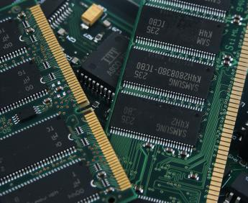
All computers were created equal: or: below please find any computer basic architecture
i.e. the Hard Disk
The RAM (random access memory)

Slide 19
Ok, back to the basics – we’ll be on the Cloud again later on

Slide 20
About the Hardware – any computer

Slide 21
History of computing: Moore’s law
Growth of computer performance is exponential

Slide 22
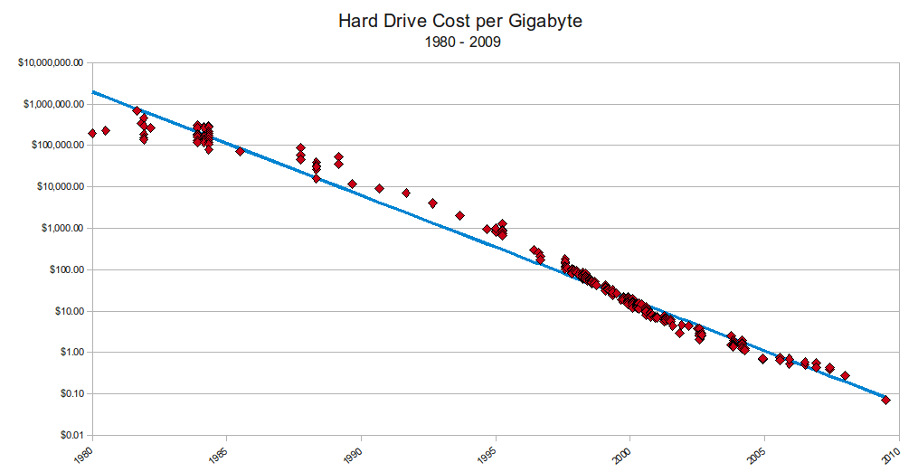
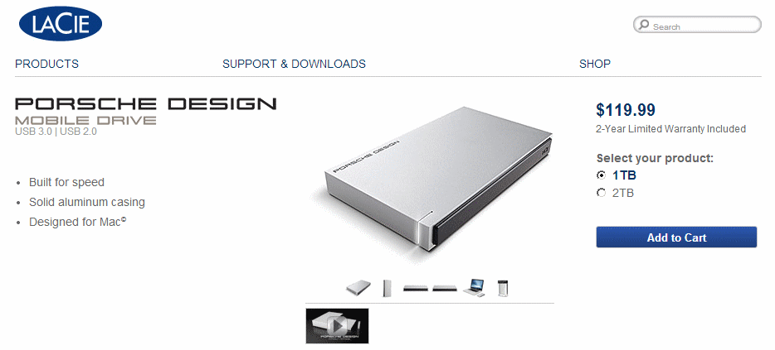
Cost of storage decreases
Storage is getting cheaper
It’s cheaper to add storage rather than manage it.
Capacity on Demand is a great idea
Backed up data is always recoverable.
SAN will lower my costs
1 TB = 1000 GB = 1.000.000 MB = approx 1.428 HD movies
(ok: what is a Byte and what “Tera” means btw??)
Notes:
You know that pcs are getting cheaper an cheaper, or at least that you get more performance for the same cost in due time. Let’s see exactly how much it does….

Slide 23
Innovation v/s costs
Year | Computer | Unit Cost | Memory
1970 | IBM 370 | Monthly rental for a typical System/370 Model 155 having 768,000 bytes of main memory is $47,985, with a purchase price of $2,248,550. Monthly rental for a typical Model 165 with 1-million bytes of main memory is $98,715, with a purchase price of $4,674,160. | Up to 800 MB HD 768kB RAM 1 MB RAM
2013 | APPLE Top-of-the-line iMac 27” | 3.4GHz quad-core Intel Core i5 Turbo Boost up to 3.8GHz 8GB (two 4GB) memory NVIDIA GeForce GTX 775M with 2GB video memory $1,999 | 1TB hard drive 8.000 MB RAM 2.000 MB video

Slide 24
Basic trouble shooting PCs – first things first
Identify PC parts and “ports” (plugs for different use)
Power on works ? (beeps and stops, no power on at all, pc stuck)
Screen shows something meaningful ?? (check cable connected, monitor menu input selection, resolution)
Keyboard, mouse work ? (pwd writes, mouse clicks)
Network connection ok ? (check a news website, check ethernet/wifi
Others: common / ask the internet
Common: keyboard usage, language, output to overhead, volume, drivers what àre and how to install or detect issue.

Slide 25
Basic trouble shooting PCs – first things first
Why the pc is sometimes too slow
Lost files / how do I avoid to waste hours of work
Crashes of the pc, the blue screen and other reasons to crash. Check for viruses (use
Viruses, what they are and what antivirus/firewall programs to use
Printer / drivers / installation of peripherals
Battery life
Complex SW: sometimes the software is too complicated to understant (pls read the manuals)
Mouse freeze
Spam mail
Network failure
Upload failure
Usb fail to identify device

Slide 26
Basic trouble shooting PCs – first things first
Why the pc is sometimes too slow
Latest version software n old (> 5 yrs ago) computers), reinstall older versions if you can, do not upgrade
Too many programs open use task manager (ctrl-alt-del on win, alt-tab on MacOS) and close them
Insufficient memory: add RAM
Lost files / how do I avoid to waste hours of work
learn to save periodically the open file
"save as" when you open attachments directly from mail

Slide 27
Basic trouble shooting PCs – first things first
Crashes, the blue screen and other reasons to crash.
Microsoft suggestions for a computer crash
Microsoft support page for Win 7
Mac troubleshooting: How to handle freezes and crashes
How easy is to crash a computer ? Example
STEP:1- Open Notepad on your PC
STEP:2- copy it from here to your Notepad
%0|%0
STEP:3- Then save it with a .bat extension.
When saving delete the .txt and input the File name with the .bat extension
Example:- fork.bat
STEP:4- Once anyone will do double click on this bat file, his COMPUTER WILL JAMM AND CRASH

Slide 28
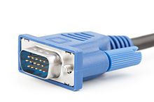
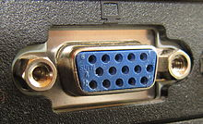
Computer “ports” : hardware ports v/s software ports
HW ports
In computer hardware, a port serves as an interface between the computer and other computers or peripheral devices. Physically, a port is a specialized outlet on a piece of equipment to which a plug or cable connects. Electronically, the several conductors making up the outlet provide a signal transfer between devices.
Port connectors may be male or female, but female connectors are much more common. Bent pins are easier to replace on a cable than on a connector attached to a computer, so it was common to use female connectors for the fixed side of an interface.
SW ports, see later on
male connector female connector

Slide 29
Hardware ports type
Based on the figure identify all ports on your desktop and check where and if they are connected

Slide 30
Resources to troubleshoot PCs
http://computer.howstuffworks.com/23-computer-tour-video.htm
http://www.computerhope.com/basic.htm

Slide 31
PC beeps, power on failure, sleep
If the PC does not power on
System BIOS (basic I/O software) corrupted: try a CD start-up
Basic Input/Output System (BIOS), also known as System BIOS, ROM BIOS or PC BIOS (/ˈbaɪ.oʊs/), is a de factostandard defining a firmware interface.^{[1]} The name originated from the Basic Input/Output System used in the CP/M operating system in 1975.^{[2][3]} The BIOS software is built into the PC, and is the first software run by a PC when powered on. The fundamental purposes of the BIOS are to initialize and test the system hardware components, and to load a bootloader or an operating system from a mass memory device.
Battery life ended: (old PCs left off longtime: leave machine plugged on, disconnect power plug or push power button for few seconds, try again in 5 mins)
Power supply to be replaced
Major problem: refer to support
Issues after power on: fail to recognize a peripheral (USB device, printer, projector, other).
DRIVERS: before any peripheral can operate on the pc (OR Mac)the appropriate software must be installed (i.e. the so called “driver”).
Usually USB peripherals now install themselves automatically. ALWAYS CHECK INSTRUCTIONS BEFORE PLUG IN ANY PERIF. If the perif is not self-installing, and no drivers are correctly installed, the perif will not work usually even after drivers instal. I.E. DRIVERS INSTALLED BEFORE PLUGGING NOT SELF-INSTALLING perif.

Slide 32
Software system (desktop examples)
You (or someone else…)
MS Office or Open Office
Windows , MAC OS X,
Your PC

Slide 33
Most common Operating Systems
Microsoft Windows family
Unix / Linux
Mac OS
Parallel, real-time, mainframe OS

Slide 34
Application software
also known as applications or apps,
is computer software designed to help the user to perform singular or multiple related specific tasks.
Examples include Enterprise software, Accounting software, Office suites, Graphics software and media players.

Slide 35
The FILE SYSTEM (this IS very important)
Anything on a computer is stored in a FILE
FILES are organized in DIRECTORIES aka « folders »
Files can be either on your PC (« local » ) or on the « local network » or on the Internet (« cloud »)

Slide 36
Local computing, Intranet, Internet, cloud
LOCAL (storage or installation) means files are physically on a single PC, or laptop. You can have many local installations of the same files but files are not automatically synced
Local Area Network, or LAN,
a computer network that interconnects computers in a limited area such as a home, school, computer laboratory, or office building using network media. E.G. the JCU “Intranet”.
You can access files ONLY if connected within the premises of the LAN
LAN using Internet protocol are called “INTRANET”
Internet is the network connecting all local network and computers adopting the TCP/IP protocol
Software can be stored on the Internet and directly used “as a platform” or “as a service” (“SaaS”).
The Internet is traditionally graphically represented as a cloud computing, hence this method of operation is called “Cloud Computing”. Examples of distributed systems: Google Suite on Google Drive

Slide 37
An Intranet
An intranet is the use of Web technologies to create a private network, usually within one enterprise.
It is typically a complete LAN, or several intra-connected LANs
Intranets are used for:
work-group activities
the distributed sharing of projects within the enterprise
Controlled access to company financial documents
use of knowledge management, research materials, online training, and other information that requires distribution within the enterprise.

Slide 38
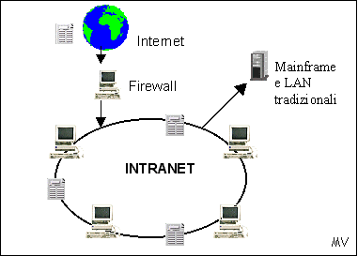
Intranet v/s Internet

Slide 39
The Internet
Sometimes called simply “the Net,” the Internet is a worldwide system of computer networks—a network of networks hence Internet, in which users at any one computer can get information from any other computer
The Internet uses a portion of the total resources of the currently existing public telecommunication networks. Technically, what distinguishes the Internet is its use of a set of protocols called TCP/IP (Transmission Control Protocol/Internet Protocol).

Slide 40
Extranet
Connect several intranets via the Internet, by adding a security mechanism and some additional functionalities
They form a larger virtual network that allows remote users (such as business partners or mobile employees) to securely connect over the Internet to the enterprise’s main intranet.
Extranets are also employed by two or more enterprises (suppliers & buyers) to share information in a controlled fashion, and therefore they play a major role in the development of business-to-business electronic commerce and Supply Chain systems.

Slide 41
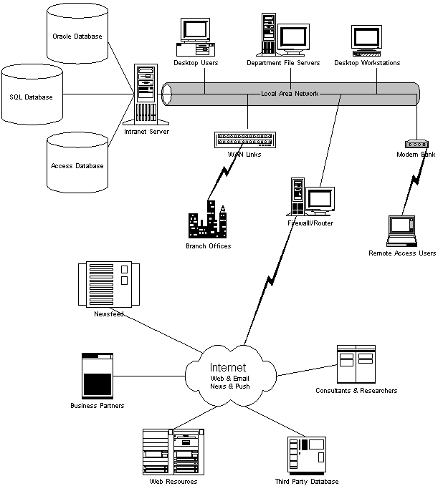
Intranet v/s Internet, 2
JCU facilities
PC Lab is here
X disk
FTP area
web sites (e.g. Facebook)
The “FIREWALL”
connects
intranet to internet
Rest of the World
(your laptop is here, at home)

Slide 42
The World Wide Web
Runs on the Internet, Intranet, Extranet
Uses the Hypertext Protocol (HTTP)
We just call it the Internet, but it is a subset of it

Slide 43
Real systems are a bit more complex, yes...

Slide 44
Cloud computing

Slide 45
Cloud Computing : software as a service

Slide 46
Could computing types

Slide 47
Local v/s Network
Local = on your machine(e.g.C:/programs)
Local Network = « Intranet »
X: shared disk (user permissions, permanent)
O: temporary area (cleared periodically)
Accessible only from within JCU premises
Network, a.k.a. « cloud »
Google docs / Icloud / Dropbox / Slideshare / … many …
MS Office 365 / 2013

Slide 48
Google Apps (ex Google docs) : a simple cloud computing

Slide 49
Google Apps: let’s try it
Google Drive (formerly: Google Docs) is a free, Web-based word processor, spreadsheet, presentation, form, and data storage service offered by Google. It allows users to create and edit documents online while collaborating in real-time with other users.

Slide 50
Google Apps: a simple cloud computing
Use a gmail account (preferred, register now if you do not have one)
Send me a mail to sgazziano@johncabot.edu
Wait for the invitation to access the file
Follow my instructions in class

Slide 51
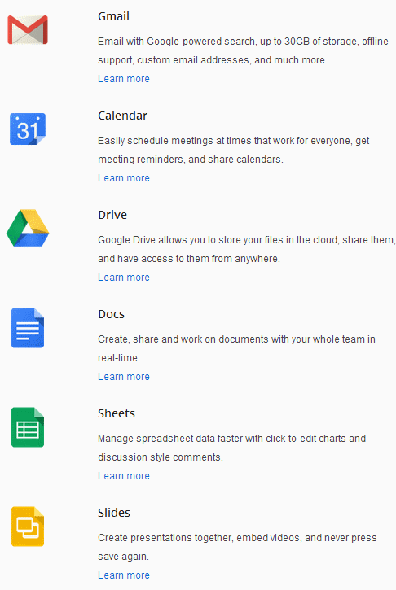
Personal productivity SW:
Google Apps net suite
Apache OpenOffice
Microsoft Office
Simple Integration of documents

Slide 52
Apache Open Office 4
commonly known as OpenOffice, or AOO
Apache OpenOffice (AOO) is an open-source office productivity software suite. It descends fromOpenOffice.org and IBM Lotus Symphony,^{[5]} and is a close cousin of LibreOffice.
Apache OpenOffice contains a word processor (Writer), a spreadsheet (Calc), a presentation application (Impress), a drawing application (Draw), a formula editor (Math), and a database managementapplication (Base).^{[6]}
Apache OpenOffice's default file format is the OpenDocument Format (ODF), an ISO/IEC standard, which originated with OpenOffice.org. It can also read a wide variety of other file formats, with particular attention to those from Microsoft Office.
Apache OpenOffice is developed for Linux, OS X and Windows, with ports to other operating systems. It is distributed under the Apache License.^{[4]} The first release was version 3.4.0, on 8 May 2012.^{[1]}

Slide 53
Apache Open Office 4

Slide 54
Other personal productivity software
WinZIP: file compressione / decompression
Image processing software: Photofiltre

Slide 55
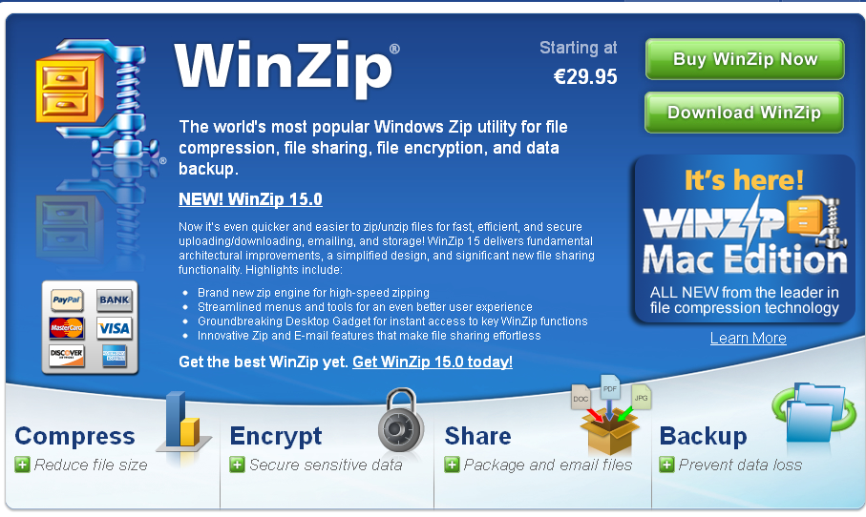
Other personal productivity software
ZIP / Winzip – compress archives

Slide 56
Win Zip & co. – Compressing archives
My tutorial on Winzip: available on Myjcu

Slide 57
Win Zip & co. – Compressing archives
The folder is COMPRESSED

Slide 58
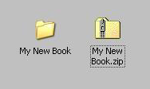
Win Zip & co. – Compressing archives
The folder is COMPRESSED
So we now have two folders
The original folder
The “zipped” (compressed) folder

Slide 59
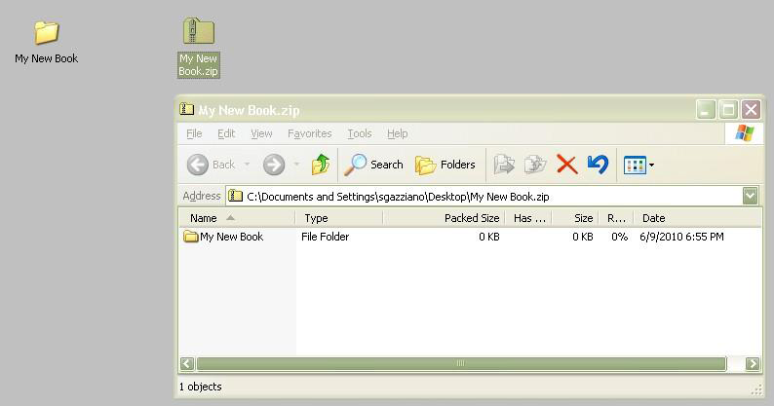
Win Zip & co. – Compressing archives
The “zipped” (compressed) one
contains the original folder, packed
WARNING: Windows makes the zipped folder “look like” a regular folder to the user but IT IS NOT a normal folder.

Slide 60
ZIPPED is not a regular folder
This is a regular folder, file exist in the “Desktop” folder
This is a “ZIPPED”, i.e. Compressed folder, if you open files here, they will be seen by the user as “look alike” regular files, but they do not exist in “Desktop”, rather in a “TEMP” folder, deleted after closing files.

Slide 61
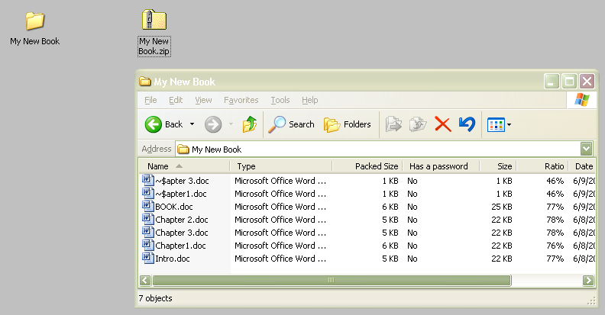
Win Zip & co. – Compressing archives
The “zipped” (compressed) one contains the original folder, packed, which in turn contains the original files, packed

Slide 62
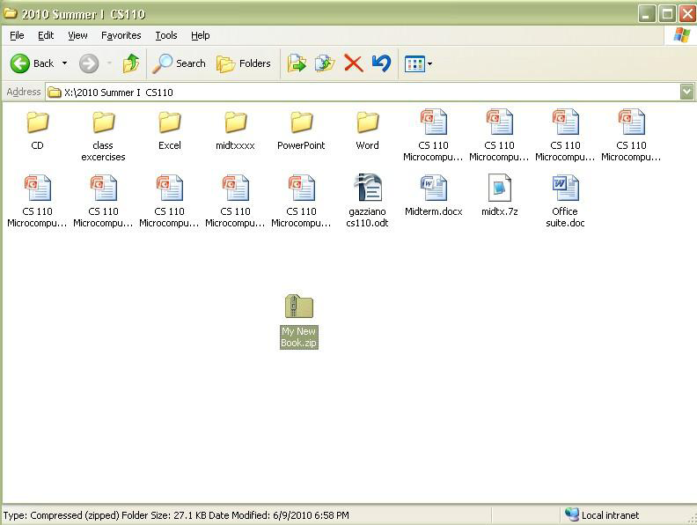
Win Zip & co. – Compressing archives
The “zipped” (compressed) folder is moved somewhere else

Slide 63
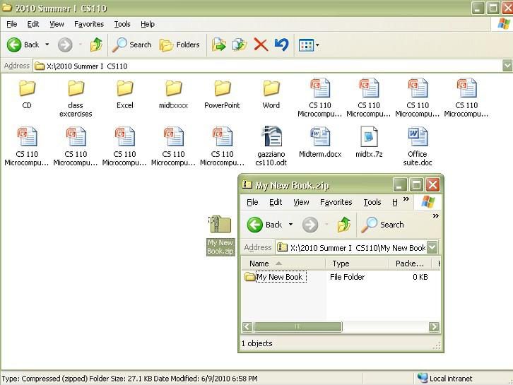
Win Zip & co. – Compressing archives
Somewhere else, the compressed folder is “expanded”,
see the original folder inside ?

Slide 64
Internet as a resource tutorial
3 steps, 3 different actions
Search content
Use Text
Use Images

Slide 65
Internet as a resource tutorial
Search for information
Info must be confirmed (by other web sites) better not trust a single source
Quantitative info must come from a realible or authoritative source (someone with a good reputation, like UN, Intl Agencies, BBC, ...)
Reliable sources are those quoted by other sites most often

Slide 66
Internet as a resource tutorial
Use text from web sites
The technique is :
select , copy (mouse operation, careful about margins)
unformat (paste into “notepad” or similar editor, then reselect and copy)
paste into final (i.e. Word) document

Slide 67
Internet as a resource tutorial
Use images
Technique is :
Right-click
Save as, file on your pc
Modify (crop, resize, adjust) using a photo retouch SW (e.g. Photofiltre)
Save as .JPG or .GIF
Insert in the document

Slide 68
Grahics editing software
A program or collection of programs that enable a person to manipulate visual images on a computer.
Computer graphics can be classified into two distinct categories: raster graphics and vector graphics. Many graphics programs focus exclusively on either vector or raster graphics, but there are a few that combine them in interesting ways. It is simple to convert from vector graphics to raster graphics, but going the other way is harder. Some software attempts to do this.
In addition to static graphics, there are animation and video editing software.
Most graphics programs have the ability to import and export one or more graphics file formats.

Slide 69
Examples of graphics editing software
Adobe Photoshop
Paintshop Pro
GIMP
Photofiltre (we have it installed, easier than most)
... There are sooo many others ...

Slide 70
Image file formats
Compare different file formats here

Slide 71
Image file formats
GIF - The Graphics Interchange Format is a bitmap image format introduced by CompuServe in 1987 used on the World Wide Web due to its wide support and portability.
The format supports up to 8 bits per pixel for each image, allowing a single image to reference its own palette of up to 256 different colors Supports animations and allows a separate palette of up to 256 colors for each frame. These palette limitations make the GIF format unsuitable for reproducing color photographs and other images with continuous color, but it is well-suited for simpler images such as graphics or logos with solid areas of color.
Compare different file formats here

Slide 72
Image file formats - JPG
JPG - The term "JPEG" is an acronym for the Joint Photographic Experts Group. JPG compression algorithm is at its best on photographs and paintings of realistic scenes with smooth variations of tone and color. For web usage, where the amount of data used for an image is important, JPEG is very popular. JPEG/Exif is also the most common format saved by digital cameras.
TRUE COLOR
LARGER SIZE THAN GIF
Compare different file formats here

Slide 73
Image file formats
Compare different file formats here
PNG - On small images, GIF can achieve greater compression than PNG. On most images, except for the above case, a GIF will have a larger file-size than an indexed PNG.
PNG gives a much wider range of transparency options than GIF, including alpha channel transparency. Truecolor, allowing for greater color precision, smoother fades, etc.^{[24]}
GIF intrinsically supports animated images. PNG supports animation only via unofficial extensions (see the section on animation, above).
PNG images are less widely supported by older browsers. In particular, IE6 has limited support for PNG.

Slide 74
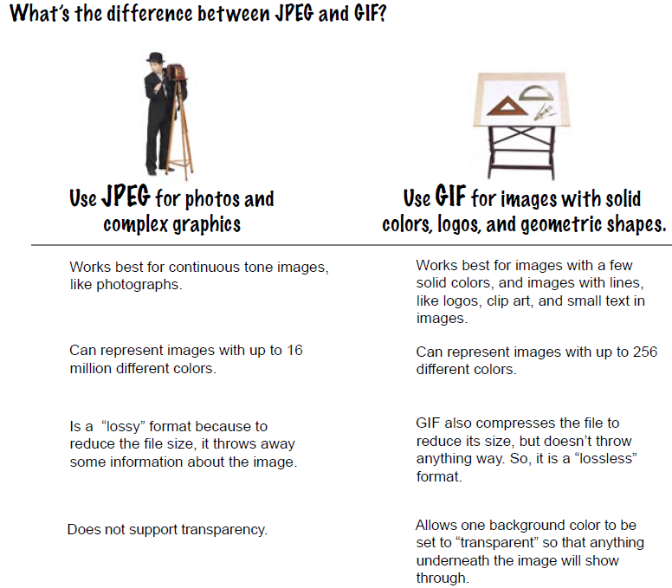
Image file formats

Slide 75
Photofiltre tutorials
http://photofiltre.free.fr/tutorials_en.htm
http://hopelessthunder.org/tutorials/photofiltre/

Slide 76
First test on integration of documents - 1
Test - this is GRADED : due by wed 21 sept
Find the cost of a programmer, a system manager, a project manager in:
USA or European Union
India
China
Write a single-page paper using MS Word, using copy and paste, using a selection of text taken from http://en.wikipedia.org/wiki/Offshore_software_R%26D and quote the costs you’ve found. (mention the costs and the source)
Find and include a suitable picture (Google search images)

Slide 77
First test on integration of documents - 2
When you’re done with the “paper”
ZIP THE FILE – NAME IT YOURNAME.ZIP
EMAIL THE ZIPPED FILE TO SGAZZIANO@JOHNCABOT.EDU
SHARE IN GOOGLE DOCS TO GAZZIANO@GMAIL.COM

Slide 78
MS Office Introduction
Operating systems . File systems and file/folder management.
PC, Intranet and Network. File management. Cloud computing and storage.
Personal productivity SW: Office (Microsoft, OpenOffice, Google net suite) Simple Integration of documents
MS Office: Excel. Word and Powerpoint. Basic and advanced features. Document integration.

Slide 79
MS Office – common features
Office button, quick access toolbar, title bar
Ribbon
Status Bar

Slide 80
MS Office – common features
Keyboard shortcuts common to all Office
CTRL-F1 (hide/show ribbon)
ALT-F (display Office Menu)
Customizing Toolbar (r-click end toolbar)

Slide 81
MS Office – common features
Familiarize with the ribbon
Tabs
Groups
Commands
Zoom slider
Help / screentips (point and wait)
The MS Office online link

Slide 82
MS Office – common features
Universal tasks
Opening / saving a file
Types of file
Printing / previewing / print options
The MS Office online link

Slide 83
MS Office – common features
Basic tasks
Selecting a text to edit
Insert / overtype
The clipboard
Moving / copying text
Finding, replacing (CTRL – F)
Undo / redo command
The MS Office online link

Slide 84
MS Excel – introduction
Create a new workbook.
Enter text and numbers.
Edit text and numbers.
Insert and delete columns and rows.
The MS Online Course Overview

Slide 85
MS Excel – introduction
When you start Excel you're faced with a big empty grid. There are letters across the top and numbers down the left side. And there are tabs at the bottom named Sheet1, Sheet2, and so on
The MS Online Course Overview

Slide 86
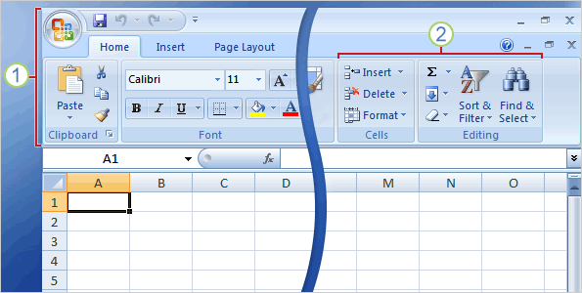
The Ribbon spans the top of Excel.
The band at the top of the Excel 2007 window is the Ribbon. The Ribbon is made up of different tabs. Each tab is related to specific kinds of work that people do in Excel. You click the tabs at the top of the Ribbon to see the different commands on each tab. The Home tab, the first tab on the left, contains the everyday commands that people use the most.
Commands are organized in small related groups. For example, commands to edit cells are grouped together in the Editing group, and commands to work with cells are in the Cellsgroup.
The MS Online Course Overview

Slide 87
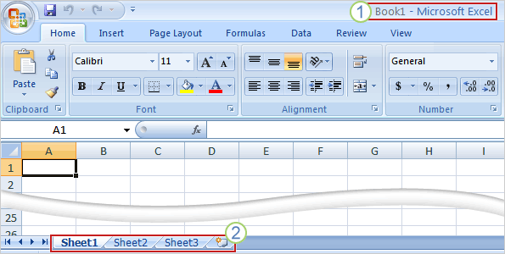
Workbooks and worksheets
When you start Excel, you open a file that's called a workbook. Each new workbook comes with three worksheets, like pages in a document. You enter data into the worksheets. (Worksheets are sometimes called spreadsheets.)
Each worksheet has a name on its sheet tab at the bottom left of the workbook window: Sheet1, Sheet2, and Sheet3. You click each sheet tab to view a worksheet.
It's a good idea to rename the sheet tabs to make the information on each sheet easier to identify. For example, you might have sheet tabs called January, February, and March for budgets or student grades for those months, or Northcoast and Westcoast for sales regions, and so on.
The MS Online Course Link

Slide 88
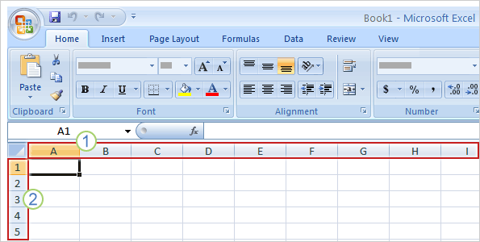
Columns and Rows
After the first 26 column headings (A through Z), the next 26 column headings are AA through AZ. The column headings continue through column XFD, for a total of 16,384 columns.
Column headings are indicated by letters.
Row headings are indicated by numbers.
The MS Online Course Link

Slide 89
Columns and Rows
Worksheets are divided into columns, rows, and cells. That's the grid you see when you open up a workbook.
Columns go from top to bottom on the worksheet, vertically. Rows go from left to right on the worksheet, horizontally. A cell is the space where one column and one row meet.
Each column has an alphabetical heading. The first 26 columns have the letters from A through Z. Each worksheet contains 16,384 columns in all, so after Z the letters begin again in pairs, AA through AZ. After AZ, the letter pairs start again with columns BA through BZ, and so on, ending at XFD.
Each row also has a heading. Row headings are numbers, from 1 through 1,048,576.
The headings combine to form the cell address, also called the cell reference.
The MS Online Course Link

Slide 90
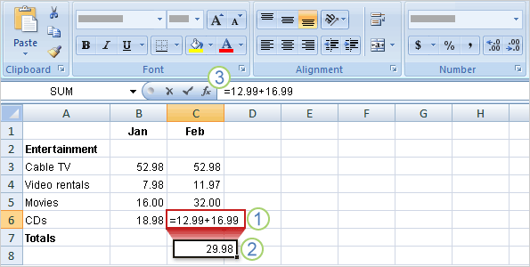
Formulas
Begin with an equal sign
The plus sign (+) is a math operator that tells Excel to add the values.
If you wonder later on how you got this result, the formula is visible in the formula bar near the top of the worksheet whenever you click in cell C6 again.
MS Office online link

Slide 91
Formulas
To do more than add, use other math operators as you type formulas into worksheet cells.
Use a minus sign (-) to subtract, an asterisk (*) to multiply, and a forward slash (/) to divide. Remember to always start each formula with an equal sign.
MS Office online link

Slide 92
Excercise: gradebook - 1
Find gradebook.xls on myjcu
Complete sheet 1 and sheet 2 using formulas
Save using yourname_gradebook1.xls
Mail to sgazziano@joncabot.edu

Slide 93
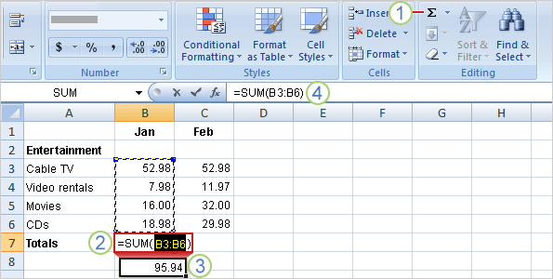
Functions
A FUNCTION is a preconstructed formula that makes difficult computation less complicated
MS Office online link

Slide 94
Functions
To add up the total of expenses for January, you don't have to type all those values again. Instead, you can use a prewritten formula, called a function.
You can get the January total in cell B7 by clicking Sum in the Editing group on theHome tab. This enters the SUM function, which adds up all the values in a range of cells. To save time, use this function whenever you have more than a few values to add up, so that you don't have to type the formula.
Pressing ENTER displays the SUM function result 95.94 in cell B7. The formula =SUM(B3:B6) appears in the formula bar whenever you click in cell B7.
MS Office online link

Slide 95
Functions
B3:B6 is the information, called the argument, that tells the SUM function what to add. By using a cell reference (B3:B6) instead of the values in those cells, Excel can automatically update results if values change later on. The colon (:) in B3:B6 indicates a cell range in column B, rows 3 through 6. The parentheses are required to separate the argument from the function.
The next two lessons explain cell references and functions in more detail.
Tip The Sum button is also on the Formulas tab. You can work with formulas no matter what tab you work on. You might switch to the Formulas tab to work with more complex formulas, which are explained in other training courses.
MS Office online link

Slide 96
Excercise: gradebook - 2
Find gradebook.xls on myjcu
Complete sheet 1 and sheet 2 using functions (exclude for now the grade col)
Save using yourname_gradebook2.xls
Mail to sgazziano@joncabot.edu

Slide 97
Relative and Absolute
cell addresses
A RELATIVE CELL REFERENCE within a formula is a cell reference that changes relative to the direction in which the formula is being copied (B1).
An ABSOLUTE cell reference in a formula, on the other hand, is the one that stays the same no matter where you copy a formula.
An ABSOLUTE cell reference appears with dollar signs before both the column and the row number ($B$1).
This IS VERY VERY important !!!
MS Office online link

Slide 98
The IF function
The IF function returns one value if a condition you specify evaluates to TRUE, and another value if that condition evaluates to FALSE.
For example, the formula =IF(A1>10,"Over 10","10 or less") returns "Over 10" if A1 is greater than 10, and "10 or less" if A1 is less than or equal to 10.

Slide 99
The IF function
The IF function syntax has the following arguments (argument: A value that provides information to an action, an event, a method, a property, a function, or a procedure.):
logical_test Required. Any value or expression that can be evaluated to TRUE or FALSE. For example, A10=100 is a logical expression; if the value in cell A10 is equal to 100, the expression evaluates to TRUE. Otherwise, the expression evaluates to FALSE. This argument can use any comparison calculation operator.
value_if_true Required. The value that you want to be returned if the logical_test argument evaluates to TRUE. For example, if the value of this argument is the text string "Within budget" and the logical_test argument evaluates to TRUE, the IF function returns the text "Within budget." If logical_test evaluates to TRUE and the value_if_true argument is omitted (that is, there is only a comma following the logical_test argument), the IF function returns 0 (zero). To display the word TRUE, use the logical value TRUE for the value_if_true argument.
value_if_false Optional. The value that you want to be returned if the logical_test argument evaluates to FALSE. For example, if the value of this argument is the text string "Over budget" and the logical_test argument evaluates to FALSE, the IF function returns the text "Over budget." If logical_test evaluates to FALSE and the value_if_false argument is omitted, (that is, there is no comma following the value_if_true argument), the IF function returns the logical value FALSE. If logical_test evaluates to FALSE and the value of the value_if_false argument is omitted (that is, in the IF function, there is no comma following the value_if_true argument), the IF function returns the value 0 (zero).

Slide 100
The IF function – single IF

Slide 101
The IF function – nested IFs

Slide 102
Excercise: gradebook - 3
Find gradebook.xls on myjcu
Complete sheet 1 and sheet 2 using functions, absolute references, and make the grade scale a control panel
Save using yourname_gradebook1.xls
Mail to sgazziano@joncabot.edu

Slide 103
Drop down lists
To make data entry easier, or to limit entries to certain items that you define, you can create a drop-down list of valid entries that is compiled from cells elsewhere on the worksheet. When you create a drop-down list for a cell, it displays an arrow next to that cell. To enter information in that cell, click the arrow, and then click the entry that you want.

Slide 104
Drop down lists
To create a drop-down list from a range of cells, use the Validation command under the Data menu.
To create a list of valid entries for the drop-down list, type the entries in a single column or row without blank cells. For example: A 1 Sales 2 Finance 3 R&D 4 MIS

Slide 105
Drop down lists
Select the cell where you want the drop-down list.
On the Data menu, click Validation, and then click the Settings tab.
In the Allow box, click List.
To specify the location of the list of valid entries, do one of the following:
If the list is in the current worksheet, enter a reference to your list in the Source box.
If the list is on a different worksheet in the same workbook or a different workbook, enter the name that you defined for your list in the Source box.

Slide 106
Drop down lists
Make sure that the In-cell drop-down check box is selected.
To specify whether the cell can be left blank, select or clear the Ignore blank check box.
Optionally, display an input message when the cell is clicked.
Click the Input Message tab.
Make sure that the Show input message when cell is selected check box is selected.
Type the title and text for the message (up to 225 characters).
Specify how you want Microsoft Office Excel to respond when invalid data is entered.
SEE THE OFFICE TUTORIAL LINK

Slide 107
Vlookup Hlookup functions
In Excel, the VLOOKUP function searches for value in the left-most column of table_array and returns the value in the same row based on the index_number.

Slide 108
Vlookup Hlookup functions
The syntax for the VLOOKUP function is:
VLOOKUP( value, table_array, index_number, [not_exact_match] )
value is the value to search for in the first column of the table_array.
table_array is two or more columns of data that is sorted in ascending order.
index_number is the column number in table_array from which the matching value must be returned. The first column is 1.
not_exact_match is optional. It determines if you are looking for an exact match based on value. Enter FALSE to find an exact match. Enter TRUE to find an approximate match, which means that if an exact match if not found, then the VLOOKUP function will look for the next largest value that is less than value. If this parameter is omitted, the VLOOKUP function returns an approximate match.

Slide 109
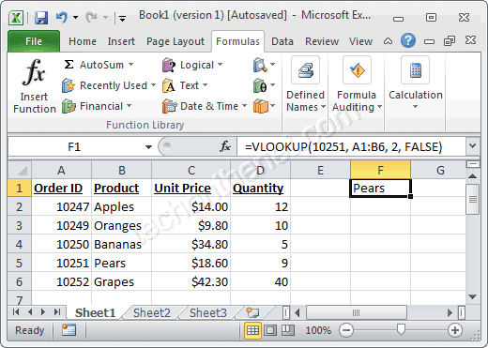
Vlookup Hlookup functions

Slide 110
Excel Macros
http://www.youtube.com/watch?v=wH03Xnr3Pug

Slide 111
MS Office: Excel.
Principles of modeling.
Charts

Slide 112
Financial Modeling with Excel Spreadsheets
Spreadsheets can be used for more than just creating tables and charts and summarizing data.
Although spreadsheets were originally designed to function as electronic ledgers and accounting worksheets, they are now commonly used for creating complex mathematical models.
Instead of just storing, summarizing, and formatting data, a financial model is used for analysis.

Slide 113
Financial Modeling with Excel Spreadsheets
What is a Model?
Generally, a financial model consists of one or more input parameters along with data and formulas that are used to perform calculations or make predictions.
By changing the values of the input parameters, you can do "what-if" studies to see what happens when the inputs change.
Some examples of financial models are the financial calculators that can be downloaded for free from this site.

Slide 114
Spreadsheets

Slide 115
Financial Modeling with Excel Spreasheets
Components of a financial (or any other) MODEL:
Data
Charts
Functions
Graphics
Now, let us see one by one this issues, hands-on

Slide 116
Financial Modeling with Excel Spreadsheets
Let us first analyze a Home Mortgage Calculator
Get the file “home-mortgage-calculator.xls”
On myjcu CS110 shared files
(too big to be uploaded on Google Docs, we meet a “cloud” limit, tsk tsk)

Slide 117
Financial Functions
Let us learn all we need to make a Home Mortgage Calculator ourselves
Remember FUNCTIONS ??
There are very many, ready, for financial data

Slide 118
Charts 101
Next in line:
CHARTS, or how to add graphics to arid numbers
Easy things first: a VIDEO by Microsoft on Excel 2007 charts
VIDEO LINK

Slide 120
Charts
A CHART is a graphic representation of data
A DATA POINT is a numeric value that describes a single item on a chart
A DATA SERIES is a group of related data points
A CATEGORY LABEL describes a group of data points in a chart

Slide 121
First chart exercise - 1
Download the chap3_ho1_sales.xlsx file Let us work on it and create the first chart
Add the total sales using SUM function (click and drag to select cells B7:E7, then click SUM in the Editing group)
Select cells B3:E3 to select the category labels (the names of the cities).
Press and hold CTRL as you drag the mouse over cells B7:E7 (the data)

Slide 122
First chart exercise - 2
Click the INSERT tab, then goto Charts group, click column
A column chart palette appears: try many types
Click the chart object to make the chart active. Click the LAYOUT tab, then chart title, and then above chart, enter “Revenue by Geographic Area”.

Slide 123
Modify Charts
You can modify any chart element to enhance the chart and improve its appearance
Some of the most common modifications include: Size, color, font, format, scale, style
Miin toolbars or shortcuts menus appear as needed for you to make selections

Slide 124
Change and edit chart elements
To edit the contents of a title, click the chart or axis title that you want to change
To edit the data labels, click twice the data label, then click again to place the title or data label in editing mode, type the new text, press enter
Format a chart using the tabs options

Slide 125
Change and edit chart elements
Change colors: right click on any column to open the format menu – select format data series – select fill in the left panel, then solid fill and then select a color from the color list
Use an image: select the data series, click shape fill, down arrow in the “shape styles” on the format tab, select picture, from the dialog box find a pic file which works well

Slide 126
Change and edit chart elements
Select data series = click on the column
SELECT = CLICK ON THE ELEMENT
… this is more or less true for everything …

Slide 127
Change and edit chart elements
Set a background picture
R click , Format chart area, select fill, picture
Add multiple data series
Select the chart
A selection appears in the data table
Change the selected data, chart will update

Slide 128
Change and edit chart elements

Slide 129
Change and edit chart elements

Slide 130
Chart distribution
Embedding Charts: copy the excel chart, open the Word doc and paste as objects.
Chart will be linked to the original excel worksheet. This is the default paste in Office 2007
Upload the worksheet DOES NOT automatically change the embedded object, you have to right click on it and select “update”
Remember both files locations must not change (word and excel) or the link is lost
Embed a chart without linking it
Just copy and paste

Slide 131
MS Word
Document formatting,
Summaries,
Sections,
Document organization

Slide 132
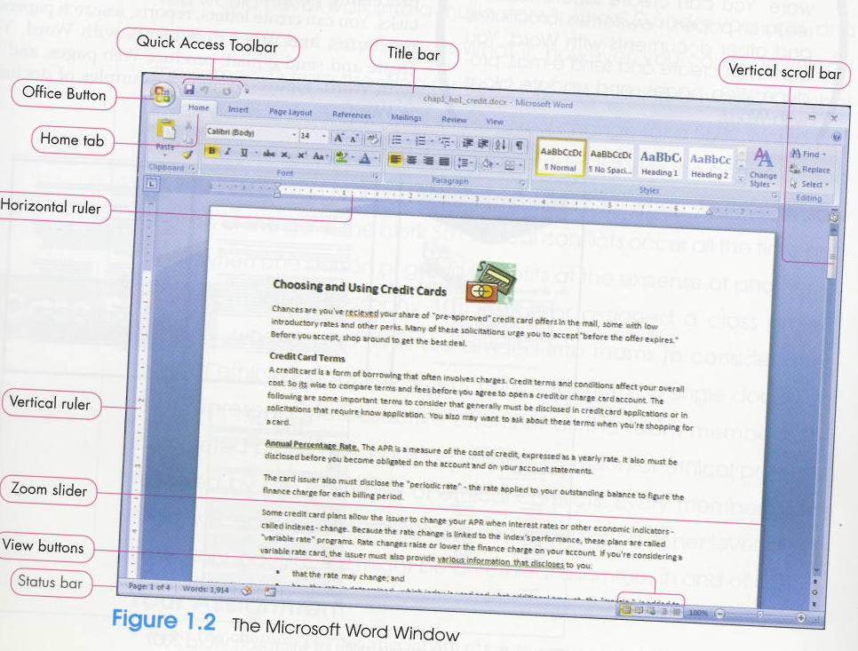
THIRD WEEK
DOCUMENT FORMATTING
MICROSOFT WORD
Document formatting,
Summaries,
Sections,
Document organization

Slide 133
MS WROD
MS Training course link
write good documents
and
… use a spelling chacker …

Slide 134
Toggle switches in Word
A toggle switch is a switch that has just two positions.
For example, light switches that turn a light on or off are toggle switches.
On computer keyboards, the Caps Lock key is a toggle switch because pressing it can have two meanings depending on what the current setting is. If Caps Lock is already on, then pressing the Caps Lock key turns it off. If Caps Lock is off, pressing the Caps Lock key turns it on.

Slide 135
Toggle switches in Word
Caps lock
Show/Hide feature /(click show/hide in the paragraph group)
Building blocks
is a way to store parts of a Word document for re-use Building Blocks can also be inserted by using Building Block galleries found on various tabs in the ribbon:
Insert tab: Cover Page, Table>Quick Tables, Header, Footer, Page Number, Text Box, Quick Parts, and Equation
Page Layout: Watermark
References: Table of Contents and Bibliography
Contextual Header & Footer Tools Design tab: Header, Footer, and Page Number
Minitoolbar
Contains frequently used formatting commands and displays when you select text

Slide 136
MS Office Keyboard shortcut
CTRL-C copies selected text into the clipboard
CTRL-V pastes text in the clipboard
CTRL-Z undo last action

Slide 137
Document formatting – how to use STYLES
The MS Formatting Help LINK
Style basics in Word
Apply a style
Create a new Quick Style
Change the formatting of a style
Add and remove styles from the Quick Styles gallery
Choose a Quick Style set for a document
Make changes to a Quick Style set
Make a Quick Style set the default style set

Slide 138
Document formatting - Style basics in Word
Using direct formatting
Word provides several ways for you to format document.
You can select the text, and, as an example, apply bold formatting, and then apply a slightly larger font size than the size that you use for the body text.
Applying formatting in this manner is known as direct formatting. The process of applying direct formatting can be tedious. It's easy to make mistakes, and you might not get a good looking document. In the example in the previous paragraph, you must repeat the direct formatting process for each heading, and you must be careful to select the same font size every time.
Furthermore, documents that are formatted by direct formatting are difficult to update. If you want to change the look of the document, you must select each element and apply the new formatting choices.

Slide 139
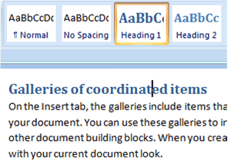
Document formatting - Style basics in Word
By contrast, when you use styles to format your document, you can quickly and easily apply a set of formatting choices consistently throughout your document.
A style is a set of formatting characteristics, such as font name, size, color, paragraph alignment and spacing. Some styles even include borders and shading.
For example, instead of taking three separate steps to format your heading as 16-point, bold, Cambria, you can achieve the same result in one step by applying the built-in Heading 1 style. You do not need to remember the characteristics of the Heading 1 style. For each heading in your document, you just click in the heading (you don't even need to select all the text), and then click Heading 1 in the gallery of styles.

Slide 140
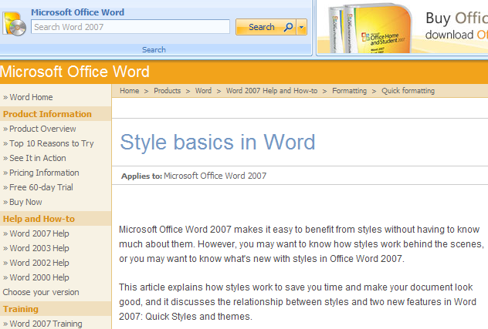
Document formatting
Style basics in Word
Using styles
Let us follow the MS Word tutorial link

Slide 141
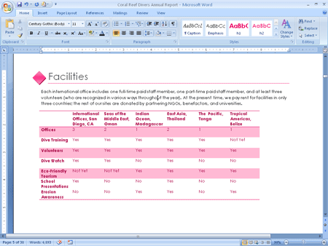
Document formatting - Style Using THEMES
What is in a THEME ?
Document Themes enable you to change the way that text, tables, and special elements are formatted throughout your document. A Theme includes the following elements:
The font used for headings and body text (including the color, style, and spacing)
Theme effects including 3-D effects, shadowing, lighting, and more

Slide 142
Document formatting
Setting margins and specifying page orientation

Slide 143
Document formatting
Inserting Page Breaks
force the next part of a document to begin on the next page
INSERT TAB – Page Break: shortcut: CRTL+ENTER
Adding page numbers
INSERT TAB - Page Number – select position from menu
Inserting Headers and Footers
A Header is information printed at the top of the page
A Footer is information printed at the bottom of the page
DESIGN TAB - look at picture next slide

Slide 144
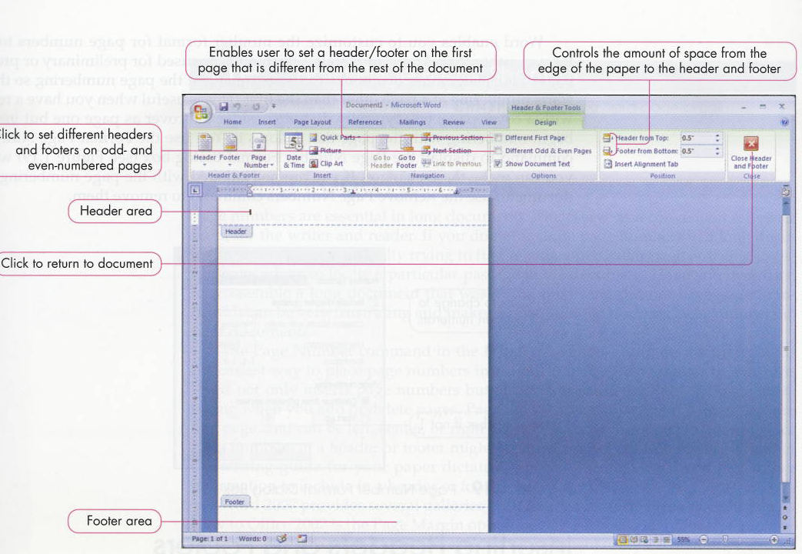
Insert header and footer

Slide 145
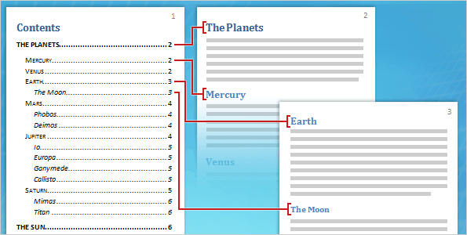
Summary and Table of Contents
The MS Training LINK

Slide 146
Pictures in Word
INSERT TAB – pictures
Right-click on pic ands select “text wrapping”
Choose the best option (usually frame) then move the pic to the final location
There is also the backgroud option available

Slide 147
General rules for a good document
Apply a structure to your document:
Titles, headings, ....
Start with the doc outline: (chapters titles)
Choose a Theme and a Style that matches your audience
Write down the content first, then format
Justify text
Frame pictures
Start new chapters on a new page if after 2/3 of page

Slide 148
MS Word
Master and subdocuments.
Tracking changes, merging documents.
Inserting references and tables

Slide 149
MS Word: Tracking changes
This chapter introduces several features that go beyond the need of the typical student and extend to capabilities that you will appreciate in the workplace, especially as you work with others on a collaborative project.
Workgroup editing: where suggested revisions from one or more individuals can be stored electronically within a document.
The original author can review each suggestion individually before it is incorporated into the final version of the document, and enables multiple people to work on the same document in collaboration with one another

Slide 150
MS Word: Tracking changes
Inserting comments in a document.
A comment is a note or annotation about the content of a document. A markup balloon is a colored circle that contains comments and display in the margins.
Click the document where you want the comment to appear, display the Review tab and click new comment in the comment group to open the markup balloon. Enter the text of your comment and click outside the balloon area.

Slide 151
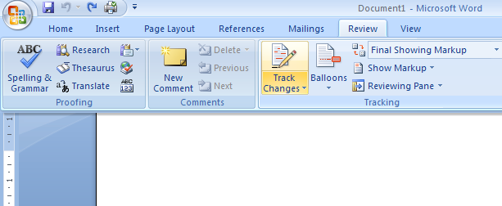
MS Word: Tracking changes
Revisions: REVIEW TAB – TRACK CHANGES
Track changes allow to insert automatic revision marks and markup balloons for changes in additions, deletions and formatting.
Whether you work individually or with a group, you can monitor any revisions you or others make to a document.
TRACKING CHANGES

Slide 152
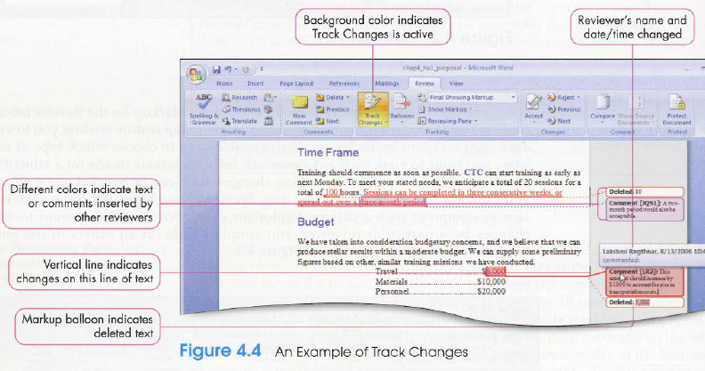
MS Word : Tracking changes

Slide 153
MS Word: Tracking changes
Original showing markup – view shows a line through deleted text and put inserted text in a markup balloon
Final showing markup – view shows inserted text in the body and puts deleted text in a markup balloon

Slide 154
VIEWING DOCUMENTS SIDE BY SIDE
The COMPARE feature evaluates the contents of two or more documents and displays markup balloons showing the differences.
View side by side and syncronous scrolling are useful when several people work on their own copy of the document

Slide 155
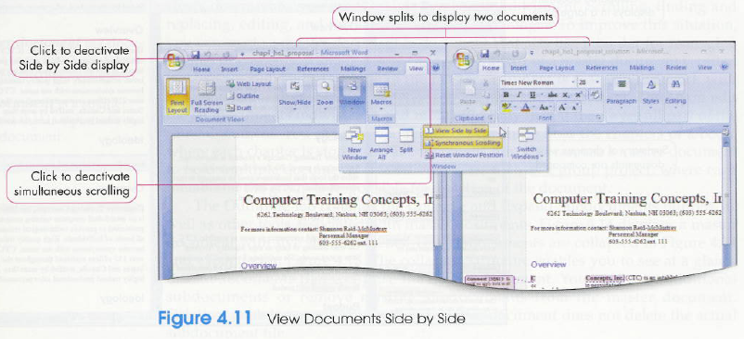
VIEWING DOCUMENTS SIDE BY SIDE

Slide 156
Master And Subdocuments
The MS Help link on master and subdocuments
Select your main folder
Open a new document or an existing one
Use View Tab – Outline command: an Outline tab appears
Create a title and headings
Make sure expand option is active
Outline tab: create subdocument

Slide 157
Tables in MS Word
see the MS support link
One of the most powerful features in Word and the basis for a limitless variety of documents. Very easy to create. Rows and Columns just like in Excel.
INSERT TAB - TABLES group - Click TABLE.
You can
- Insert and delete rows and columns
- Merge and split cells
- Change row height and column width

Slide 158
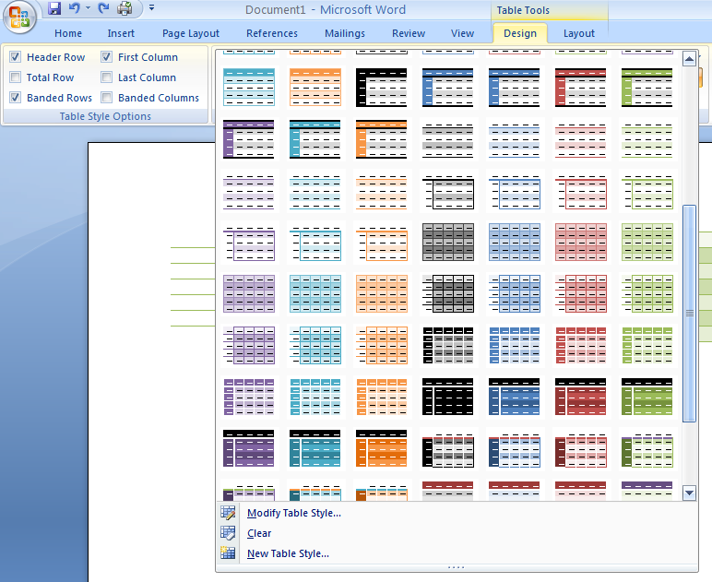
Tables in MS Word
Format Tables: use the
TABLE STYLES
in the DESIGN group

Slide 159
Files on the Web

Slide 161
Web server and web browser are different

