Slide 1

Introducing Windows Azure

Slide 2
Introducing Cloud Computing
Windows Azure

Slide 3



Add text title
Add text title
Arnon Rotem Gal-Oz has more than 20 years of experience managing, architecting and developing large scale, mission critical, distributed systems. Before joining CodeValue as VP product management, Arnon worked as VP R&D for xsights, a visual search SaaS provider. Prior to that, he worked in various technical and managerial roles in large corporations including Microsoft, Amdocs and Matrix. Arnon published articles for various online and printed journals such as InfoQ, Dr. Dobb’s and MSDN.
Alon Fliess got his BSc degree in electrical & computer engineering from the Technion, the Israel Institute of Technology. Alon recognized as a Microsoft Regional Director (MRD) as well as Microsoft MVP. Alon is an expert in many Microsoft technologies, be it Windows internals, C++ Win32 programming, .NET with C# or C++/CLI. Alon is the co-author of the Introducing Windows 7 for Developers book. Alon gives lectures in conferences worldwide.

Slide 4
Agenda
Hello Azure Application
Introduction to Cloud Computing
The Building Blocks of Azure
Web Role, Worker Role & VM Role
Service Bus, Queues & Access Control
Azure Storage – Table Storage, Queue & SQL Azure
Architecting Cloud Applications
Porting to the cloud

Slide 5
Show me the Wizard…
Hello Azure!

Slide 6

Cloud Computing
A Game Changing Technology
Location independent computing
Shared servers ➔ resources, software, and data
Elasticity
Total Cost of Operation
Natural evolution of:
  Virtualization
  Service-Oriented Architecture
  Utility computing
Details are abstracted from consumers

Slide 7
Cloud Fundamentals
Infrastructure as a Service (IaaS): basic compute and storage resources
  On-demand servers
  Amazon EC2, VMWare vCloud
Platform as a Service (PaaS): cloud application infrastructure
  On-demand application-hosting environment
  E.g. Google AppEngine, Salesforce.com, Windows Azure, Amazon
Software as a Service (SaaS): cloud applications
  On-demand applications
  E.g. GMail, Microsoft Office Web Companions

Slide 8

The Benefits of the Cloud
The Cloud is about cheap, on-demand capacity
Windows Azure
= Managed for You | Standalone Servers | IaaS | PaaS | SaaS
Applications
Runtimes
Database
Operating System
Virtualization
Server
Storage
Networking

Slide 9

software
Acquisition cost is 10% of IT Spend
hardware
network
facilities
IT labor
management tools
power/cooling
Operating cost is 90% of IT Spend
support
maintenance
security
disaster recovery
backup
Source: IDC

Slide 10
Windows Azure
Platform as a Service
  Application Platform in the Cloud
Provides:
  Compute
    Web, Worker & VM Role
  Storage
    Blob, Table, Queue & Azure SQL Server
  Application Fabric
    Service Bus, Access Control, (Future: Cache, Integration & Composite)

Slide 11
Inside Windows Azure:
The Cloud Operating System

Slide 12
Windows Azure
Windows Azure is an OS for the data center
  Model: Treat the data center as a machine
  Handles resource management, provisioning, and monitoring
  Manages application lifecycle
  Allows developers to concentrate on business logic
Provides shared pool of compute, disk and network
  Virtualized storage, compute and network
  Illusion of boundless resources
Provides common building blocks for distributed applications
  Reliable queuing, simple structured storage, SQL storage
  Application services like access control and connectivity

Slide 13
Windows Azure Components
 | Windows Azure PaaS
Applications | Windows Azure Service Model
Runtimes | .NET 3.5/4, ASP .NET, PHP
Operating System | Windows Server 2008/R2-Compatible OS
Virtualization | Windows Azure Hypervisor
Server | Microsoft Blades
Database | SQL Azure
Storage | Windows Azure Storage (Blob, Queue, Table)
Networking | Windows Azure-Configured Networking

Slide 14
Modeling Cloud Applications
A cloud application is typically made up of different components
  Front end: e.g. load-balanced stateless web servers
  Middle worker tier: e.g. order processing, encoding
  Backend storage: e.g. SQL tables or files
  Multiple instances of each for scalability and availability

Slide 15
The Windows Azure Service Model
A Windows Azure application is called a “service”
  Definition information
  Configuration information
  At least one “role”
Roles are like DLLs in the service “process”
  Collection of code with an entry point that runs in its own virtual machine
There are currently three role types:
  Web Role: IIS7 and ASP.NET in Windows Azure-supplied OS
  Worker Role: arbitrary code in Windows Azure-supplied OS
  VM Role: uploaded VHD with customer-supplied OS

Slide 16
Role Contents
Definition:
  Role name
  Role type
  VM size (e.g. small, medium, etc.)
  Network endpoints
Code:
  Web/Worker Role: Hosted DLL
  and other executables
  VM Role: VHD
Configuration:
  Number of instances
  Number of update and fault domains

Slide 17
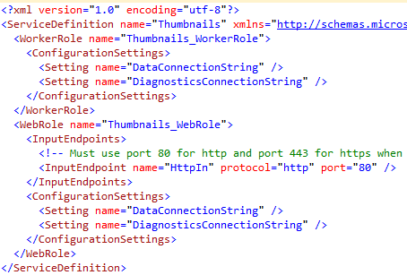
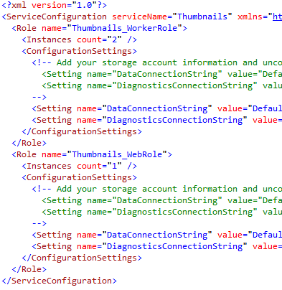

Service Model Files
Service definition is in ServiceDefinition.csdef
Service configuration is in ServiceConfiguration.cscfg
CSPack program Zips service binaries and definition into service package file (service.cscfg)

Slide 18
Availability: Update Domains
Front-End-2
Purpose: Ensure service stays up while updating and Windows Azure OS updates
System considers update domains when upgrading a service
  Update domains/Instance count = percent of service that will be offline
  Default and max is 5, but you can override with upgradeDomainCount service definition element
The Windows Azure SLA is based on at least two update domains and two role instances in each role
Front-End-1
Front-End-1
Front-End-2
Update Domain 1
Update Domain 2

Slide 19
Availability: Fault Domains
Purpose: Avoid single points of failures
  Similar concept to update domains
  But you don’t control the updates
Unit of failure based on data center topology
  E.g. top-of-rack switch on a rack of machines
Windows Azure considers fault domains when allocating service roles
  E.g. don’t put all roles in same rack
Front-End-1
Front-End-2
Fault Domain 1
Fault Domain 2

Slide 20
Deploying a Service
The 10,000 foot view
Service
Service package uploaded to portal
  Windows Azure Portal Service passes service package to “Red Dog Front End” (RDFE) Azure service
  RDFE converts service package to native “RD” version
RDFE sends service to Fabric Controller (FC) based on target region
FC stores image in repository and deploys and activates service
Portal Service
RDFE
Service
US-North Central Datacenter
FC

Slide 21


The Fabric Controller (FC)
The “kernel” of the cloud operating system
  Manages datacenter hardware
  Manages Windows Azure services
Four main responsibilities:
  Datacenter resource allocation
  Datacenter resource
  provisioning
  Service lifecycle management
  Service health management
Inputs:
  Description of the hardware and network resources it will control
  Service model and binaries for cloud applications
Server
Kernel
Process
Datacenter
Fabric Controller
Service
Word
SQL Server
Exchange
Online
SQL Azure
Windows Kernel
Fabric Controller
Server
Datacenter

Slide 22
Datacenter Architecture
Datacenter Routers
Aggregation Routers and
Load Balancers
Agg
Agg
Agg
Agg
Agg
Agg
LB
LB
LB
LB
LB
LB
LB
LB
LB
LB
LB
LB
Top of Rack
Switches
Nodes
TOR
Nodes
TOR
Nodes
TOR
Nodes
TOR
Nodes
TOR
Nodes
TOR
Nodes
TOR
Nodes
TOR
Nodes
TOR
Nodes
TOR
Nodes
TOR
Nodes
TOR
Nodes
TOR
Nodes
TOR
Nodes
TOR
…
…
…
…
…
…
Racks
PDU
PDU
PDU
PDU
PDU
PDU
PDU
PDU
PDU
PDU
PDU
PDU
PDU
PDU
PDU
Power Distribution Units

Slide 23
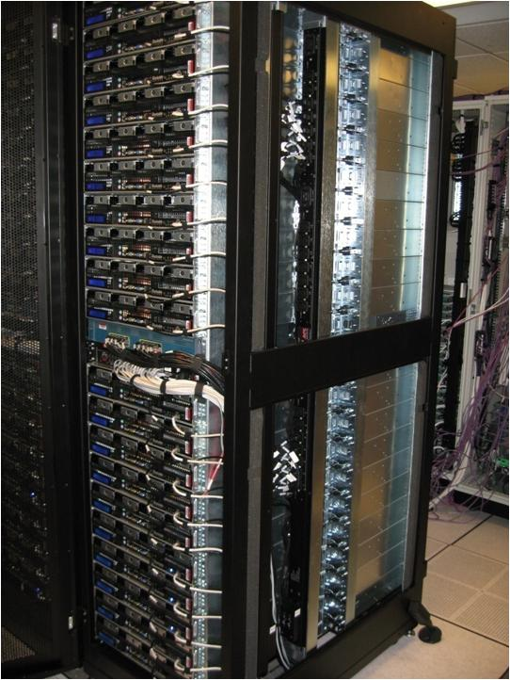
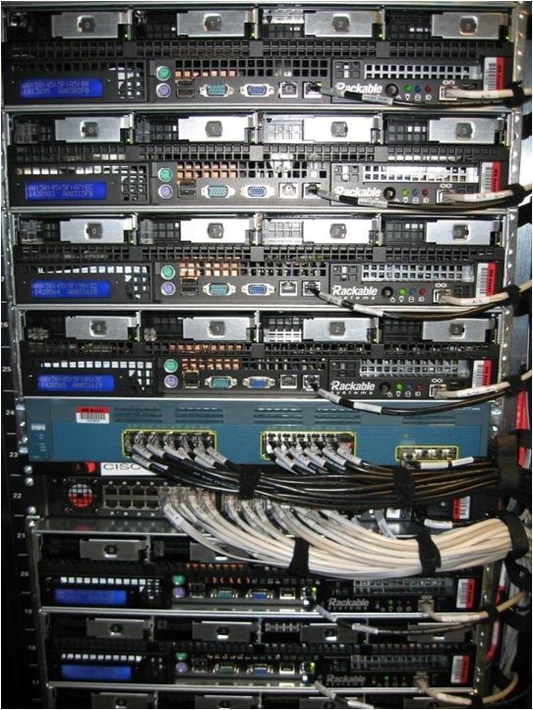
Windows Azure Datacenters

Slide 24
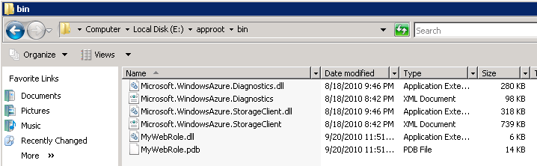
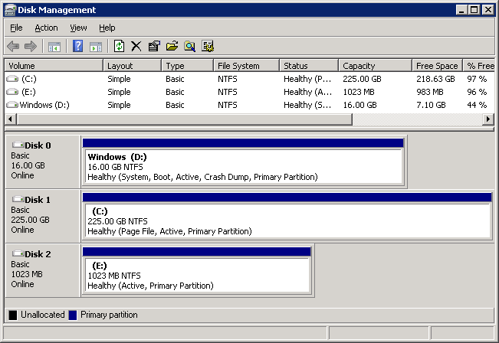
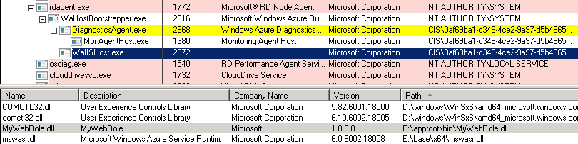
Inside a Role VM
OS Volume
Resource Volume
Role Volume
Guest Agent
Role Host
Role Entry Point

Slide 25
Update Types
There are two update types:
  In-place update:
    Supports changes to configuration or binaries, not service definition
    Role instances upgraded one update domain at a time
    Two modes: automatic and manual
  VIP swap update:
    Service definition can change, but external endpoints must remain the same
    New version of service deployed, external VIP/DIP mapping swapped with old
Changes to external endpoint count require a new deployment
Role A
UD 1
Role A
UD 2
Role A
UD 1
Role A
UD 2
Role B
UD 1
Role B
UD 2
Role B
UD 1
Role B
UD 2
In-Place Update
LB
Role A
UD 1
Role A
UD 2
Role A
UD 1
Role A
UD 2
Role B
UD 1
Role B
UD 2
Role B
UD 1
Role B
UD 2
VIP Swap Update

Slide 26
Node and Role Health Maintenance
FC maintains service availability by monitoring the software and hardware health
  Based primarily on heartbeats
  Automatically “heals” affected roles
Problem | How Detected | Fabric Response
Role instance crashes | FC guest agent monitors role termination | FC restarts role
Guest VM or agent crashes | FC host agent notices missing guest agent heartbeats | FC restarts VM and hosted role
Host OS or agent crashes | FC notices missing host agent heartbeat | Tries to recover node FC reallocates roles to other nodes
Detected node hardware issue | Host agent informs FC | FC migrates roles to other nodes Marks node “out for repair”

Slide 27
Azure Architecture Summary
Platform as a Service is all about reducing management and operations overhead
The Windows Azure Fabric Controller is the foundation for Windows Azure’s PaaS
  Provisions machines
  Deploys services
  Configures hardware for services
  Monitors service and hardware health
  Performs service healing

Slide 28
The Windows Azure Management Portal
Let’s play with it

Slide 29
Thank You!

